Slide 1
CSE as a Discipline I
Nahin Ul Sadad Lecturer CSE, RUET

Slide 2
Course Plan
Week | Contents | Lab Performance Test
Week 1 | CSE as a Discipline 1 | LP Test 1
Week 3 | Hardware 1+2
Week 5 | Software 1 | LP Test 2
Week 7 | Software 2
Week 9 | CSE as a Discipline 2 | LP Test 3
Week 11 | Ethics
Week 13 | Lab Final

Slide 3
Name of Undergraduate Degree/Major
Bachelor of Science in Computer Science & Engineering
Here, Computer Science & Engineering
=
Computer Science
+
Computer Engineering

Slide 4
Bachelors vs Diploma
Bachelors:
A bachelor's degree is an undergraduate academic degree awarded by colleges and universities. It takes 3 to 4 years to complete study. Being a more comprehensive degree, a bachelor’s degree focuses more on theoretical academic knowledge.
Diploma:
A diploma degree is an academic degree awarded by institute/polytechnic institute. It takes 1 to 2 years to complete study. A diploma degree focuses on making students ready for the job industry.
For example,
BSc in CSE will teach all the building blocks of computer science and computer engineering so that any software/hardware can be built from scratch.
Diploma in CSE will teach web development, mobile application development, graphic design, game development etc.

Slide 5
Computer Science vs Computer Engineering vs Software Engineering
Computer Science Discipline:
Computer science is a discipline that is the study of algorithmic processes and computational machines.
Algorithmic Processes = Programming + Algorithms Computational Machines = Theoretical Computer Science
Computer Engineering Discipline:
Computer Engineering is a discipline of engineering that integrates several fields of computer science and electronic engineering required to develop computer hardware and software.
Software Engineering Discipline:
Software Engineering is a discipline that focuses on an engineering approach to software development. It includes courses like: Software Requirements Analysis, Software Project Management, Design Patterns, Software Testing etc.

Slide 6
Computer Science vs Computer Engineering vs Software Engineering
Roughly,
Computer Science Discipline ≈ Software/Programming Courses Computer Engineering Discipline ≈ Hardware/Electrical Engineering Courses Software Engineering Discipline ≈ Software Management Courses
But there are many overlaps in between them.
Theoretical Computer Science (TCS):
Theoretical Computer Science (TCS) is a subset of general computer science and mathematics that focuses on mathematical aspects of computer science.
Curriculum Summary for Different Degrees:
BSc in Computer Science = 50% CS + 30% TCS + 15% CE + 5% SE BSc in Computer Engineering = 40% CS + 5% TCS + 50% CE + 5% SE BSc in Software Engineering = 30% CS + 5% TCS + 15% CE + 50% SE
BSc in Computer Science & Engineering = 50% CS + 5% TCS + 40% CE + 5% SE

Slide 7
Operating System
Information
Machine Learning
Data Mining
Digital Image Processing
Computer Security
System Analysis
Artificial Intelligence
Database
Digital Signal Processing
Software Engineering
Computer Science
Computer
Graphics
Computer
Data Structure + Algorithms
Network
Object Oriented Programming (OOP)
Software Engineering
High Level Language Programming (Structured)
Computer Engineering
Compiler
Assembly Program
Data Communication
Assembler
Peripherals & Interfacing
Machine Program
Computer Architecture
Computer Architecture
Electrical Machines & Instrumentations
Digital Electronics
Parallel and Distributed Processing
VLSI
Analog Electronics
Map of CSE
Electrical Engineering

Slide 8
CSE 3201
CSE 4203
CSE 4119
CSE 4105
CSE 4109
CSE 3207
CSE 3209
CSE 4205
CSE 3205
CSE 3101
Computer Science
CSE 4201
CSE 1201+ CSE 2201
CSE 4103
CSE 1203
Software Engineering
CSE 1101
Computer Engineering
CSE 4101
CSE 3203
CSE 2205
CSE 3105
Computer Architecture
CSE 3107
EEE 2151
CSE 2103
CSE 4211
CSE 4209
EEE 1251
Map of CSE (Course No)
EEE 1151

Slide 9
Relationship between Mathematics and CSE
Math Courses
Course 1 | Course 2 | Course 3 | Course 4 | Course 5 | Course 6 | Course 7 | Course 8
Math 1113 | Math 1213 | Math 2113 | Math 2213 | CSE 2203 | CSE 3109 | CSE 2101 | CSE 3103
Calculus | Coordinate Geometry | Vector Analysis | Complex Variable | Numerical Methods | Statistics | Discrete Mathematics | Theory of Computation
 | Ordinary Differential Equation | Linear Algebra | Partial Differential Equation |  | Queuing Theory
 |  |  | Harmonic Analysis

Slide 10
Mathematics
Numerical
Methods
Complex
Variable
Theoretical Computer Science
Vector Analysis
Queuing
Theory
Differential
Discrete Mathematics
Theory of Computation
Equations
+ Linear Algebra
Co-ordina te Geometry
Calculus
Harmonic Analysis
Graph Theory
Relations
Number Theory
Proof Techniques
Statistics
Computer Network
Database
Data Structure
+ Algorithms
Computer
Graphics
Artificial Intelligence
Digital
Signal Processing
CSE
Compiler
Data Mining
Machine Learning
Digital
Image Processing
Network Security
Computer Architecture
Relationship between Mathematics and CSE

Slide 11
Mathematics
CSE 2203
Math
2213
Theoretical Computer Science
CSE
3109
Math 1213+2213
Math 2113
CSE 2101
CSE 3103
Math 1213
Math 1113
Math 2213
Graph
Theory
Relations
Number
Theory
Proof Techniques
CSE
3109
Computer Network
Database
Data Structure
+ Algorithms
Computer
Graphics
Artificial Intelligence
Digital
Signal Processing
CSE
Compiler
Data Mining
Machine Learning
Digital
Image Processing
Security
Computer Architecture
Relationship between Mathematics and CSE

Slide 12
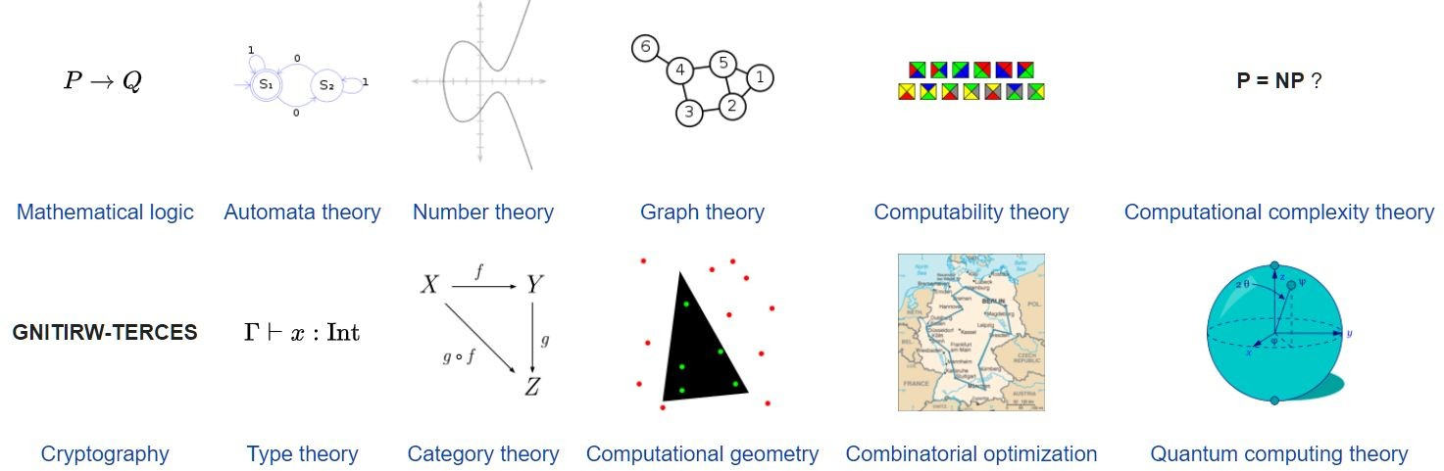
Theoretical Computer Science
Theoretical computer science (TCS) is a subset of general computer science and mathematics that focuses on mathematical aspects of computer science
Figure: Topics of TCS

Slide 13
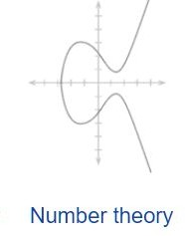
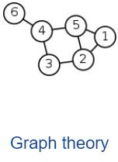
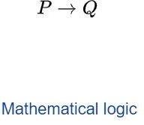
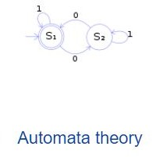
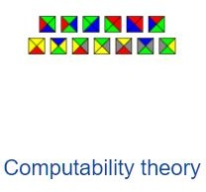
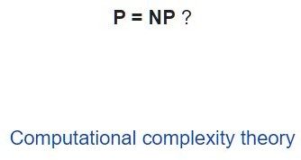
Theoretical Computer Science
There are two courses based on Theoretical Computer Science:
1. Discrete Mathematics
2. Theory of Computation

Slide 14
Discrete Mathematics
Discrete Mathematics is a branch of mathematics involving discrete elements that uses algebra and arithmetic. It is increasingly being applied in the practical fields of mathematics and computer science.
Topics of Discrete Mathematics:
Logic and Proof Techniques (Algorithms etc.)
Number Theory (Security, Cryptography etc.),
Relations (Database etc.)
Graph Theory (Networking, AI etc.)

Slide 15
Discrete Mathematics
Example of Proof Techniques:
Suppose you are writing a program to add 1 to n number. You have checked that your program gives correct answer upto n = 100000000.
Whether your program will give correct answers cannot be guaranteed until it is proved using proof techniques. This can be proved using technique called mathematical induction (গািণিতক আেরাহ পদ্ধিত).
Example of Number Theory:
The RSA encryption algorithm which is commonly used in secure commerce web sites, is based on the fact that it is easy to take two (very large) prime numbers and multiply them. While it is extremely hard to do the opposite - meaning: take a very large number, given which it has only two prime factors, and find them.
Suppose P.Q = 6, then find P and Q?
P = 2
Q = 3

Slide 16
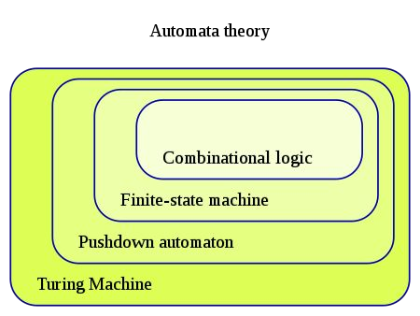
Theory of Computation
Theory of Computation deals with the definitions and properties of mathematical models of computation. These models play a role in several applied areas of computer science.
Figure: Mathematical Models of Computation

Slide 17
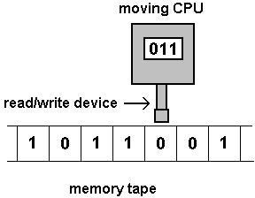
Theory of Computation
Example of Turing Machine:
Turing Machine is the mathematical model of real-life computers. It basically deals with one question: What are the fundamental capabilities and limitations of computers?
Figure: Turing Machine
All algorithms developed are based on Turing machine. It means algorithms are not written with particular CPU like Intel, AMD etc. in mind.

Slide 18
Theory of Computation
Example of Turing Machine:
It is not possible to create Turing machine in real-life as mathematical theory considers infinite memory which is not possible.
Turing machines are mathematically equivalent to each other. Modern CPUs like Intel, AMD, ARM are Turing complete which means they are mathematically equivalent to each other. It also means they are capable of running same algorithms.

Slide 19
Theory of Computation
Example of Turing Machine:
It is mathematically proved that there is no mathematical/theoretical machine that is more computationally powerful (not considering efficiency of computation) than Turing machine.
It means it is possible to speed up real-life CPU but we can not create a CPU which can compute something that Turing machine cannot.
For example, Turing machine cannot solve “Halting problem”. It also means real-life CPU cannot solve “Halting problem” no matter how powerful CPU you use.

Slide 20
Some Advices for beginners
1. Google has answers for everything.
2. Programming: Practice programming more and more. Good programming books in Bangla are-
a. কিম্পিউটার Cপ্রাগ্রািমং-প্রথম খণ্ড by তািমম শাহিরয়ার সিবনু
b. Cপ্রাগ্রািমং এক্সারসাইজ by তাহিমদ রািফ
c. কিম্পিউটার Cপ্রাগ্রািমং-িদ্বিতীয় খণ্ড by তািমম শাহিরয়ার সিবনু
d. ৫২টি Cপ্রাগ্রািমং সমস্যা ও সমাধান by তািমম শাহিরয়ার সিবনু , তাহিমদ রািফ
,
তামান্না িনশাত িরিন

Slide 21
Some Advices for beginners
Every software has free alternative:
For example, Libre office is good alternative to Microsoft Office.
Link: How to Install Libre Office 7 - Free Office Applications
Visual Studio Code (VSCode) IDE:
Install GCC compiler: How to Install MinGW (GCC/G++) Compiler in Windows 10
Install Visual Studio Code: How to install Visual Studio Code on Windows
Install Visual Studio plugin to run code easily: C++ with Visual Studio Code. (Easiest setup)

Slide 22
Some Advices for beginners
GitHub:
Beginner’s Tutorials: GitHub Tutorial - Beginner's Training Guide
Try to add a ReadMe file (Google it) to every project. Later this will be become your portfolio.
Learn to use Linux Operating System:
Install Ubuntu on Dual Mode: How to Dual Boot Ubuntu 20.04 LTS and Windows 10 | A Step by Step Tutorial | [2021] - UEFI Linux
Install Ubuntu on VirtualBox: How to Install Ubuntu 20.04 LTS on VirtualBox in Windows 10

Slide 23
Some Advices for beginners
Create Personal Website and CV (in Latex):
Free GitHub Website Hosting: How to Create & Host a Portfolio in 10 minutes with Github pages!
CV (in Latex) (This will be Taught in Technical Writing Course): How to Create a Resume or CV using Overleaf | Overleaf Latex | Part 3

Slide 24

Thank You

